Slide 1


King county, WA Housing market
A Linear Regression-based Pricing Model
By
Chamila C. Dharmawardhana, PhD

Slide 2

Project objectives
Realtor King LLC desires to have a data driven pricing model for King county Washington.
What is the current price distribution ?
What factors affects the value of a house ?
What is important to buyers and sellers?

Slide 3
About
A data driven house pricing model for King county Washington.
Seattle belongs to the King county of Washington state. In this blog I describe a multi-linear regression model to predict the housing price in King county based on machine learning. I will outline the main factors that directly relate to the house price and recommendation for both buyers and sellers.

Slide 4
Data sources and modeling constraints
Data Sources
King county housing price data from 2014 to 2015 year.
Model assumptions
Time sample: 2014 – 2015.
Region : King county, WA
Features: 19 distinct features are considered with Price as the target
Model: multivariate linear regression may be suitable for this study

Slide 5
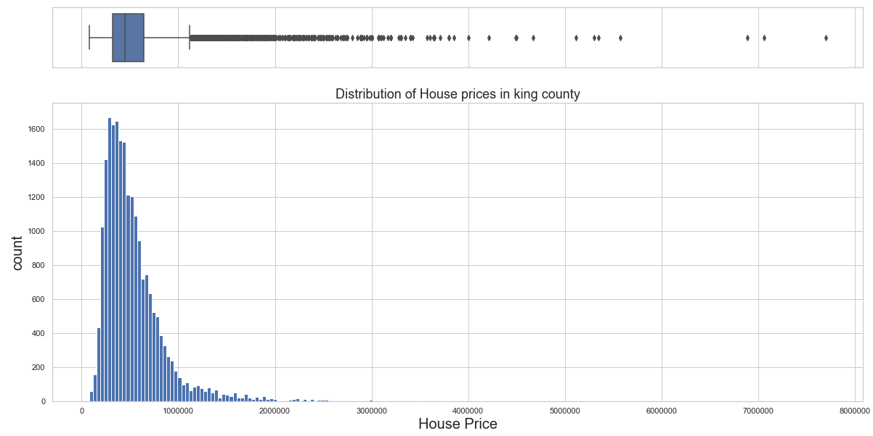
Housing price distribution (2014 – 2015)
More than 99% of the houses are less than $ 2 million

Slide 6
OSEMN Methodology
Obtain : get data, evaluate requirements and formulate set of specific questions, the project can likely answer.
Scrub: Process and clean data. Remove outliers.
Explore: analyze and visualize data as much as possible to illuminate the questions.
Model: pic a suitable ML model and fit the data. Validate the model and test for accuracy.
Interpret: more data analysis and visualization and interpret the model in order to answer the questions in the first section.

Slide 7
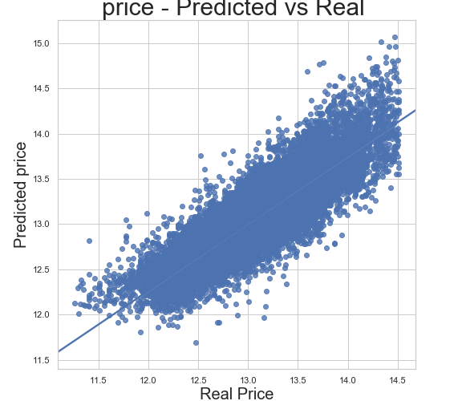
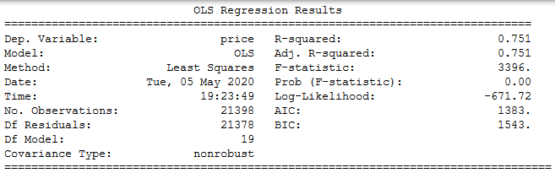
Comparison of predicted vs real
Selected features from feature engineering
zipcode | lat | long
bedrooms | bathrooms | floors
grade | condition | waterfront
yr_built | season | sqft_living
sqft_basement | sqft_lot | sqft_living15

Slide 8
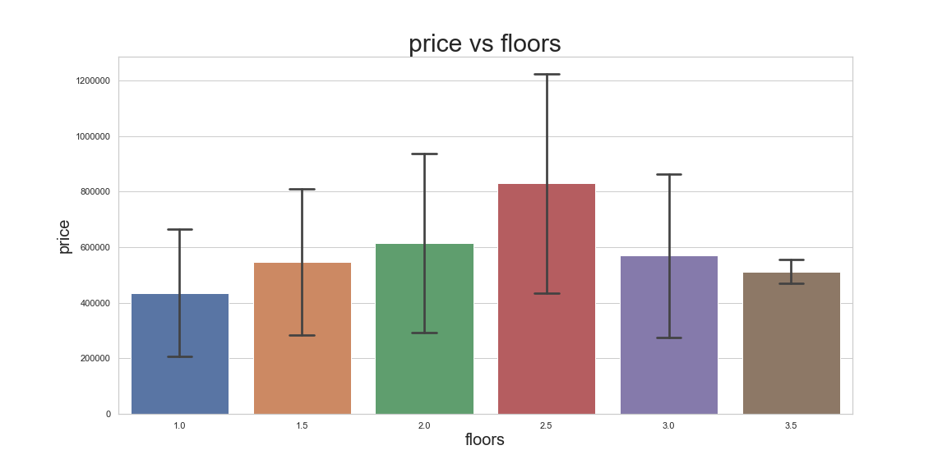
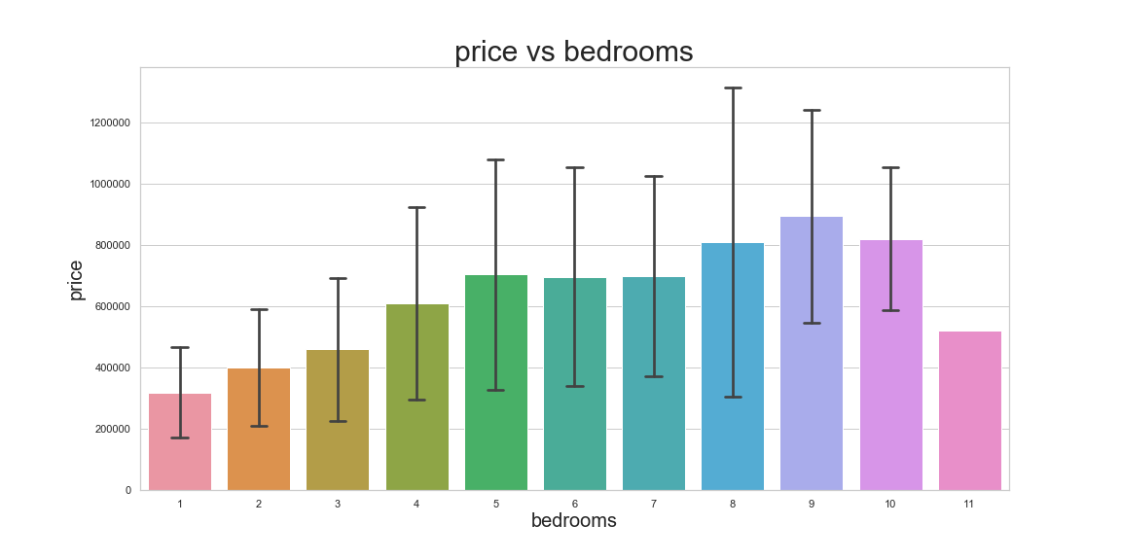
Does the size matter ?
Large variance
Mean price is linear up to 2 floors
Mean price is linear up to 5 bedrooms

Slide 9
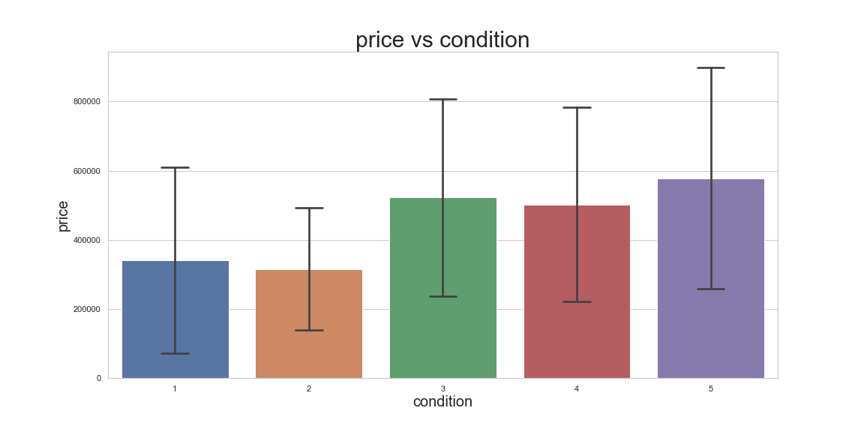
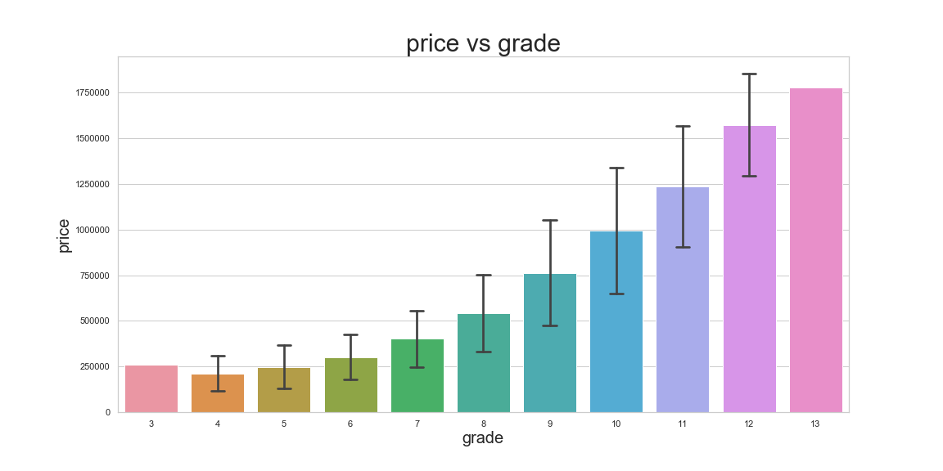
Does the look and quality matter ?
High variance
Condition > 3 will increase property value
Grade has a quadratic relationship with price

Slide 10
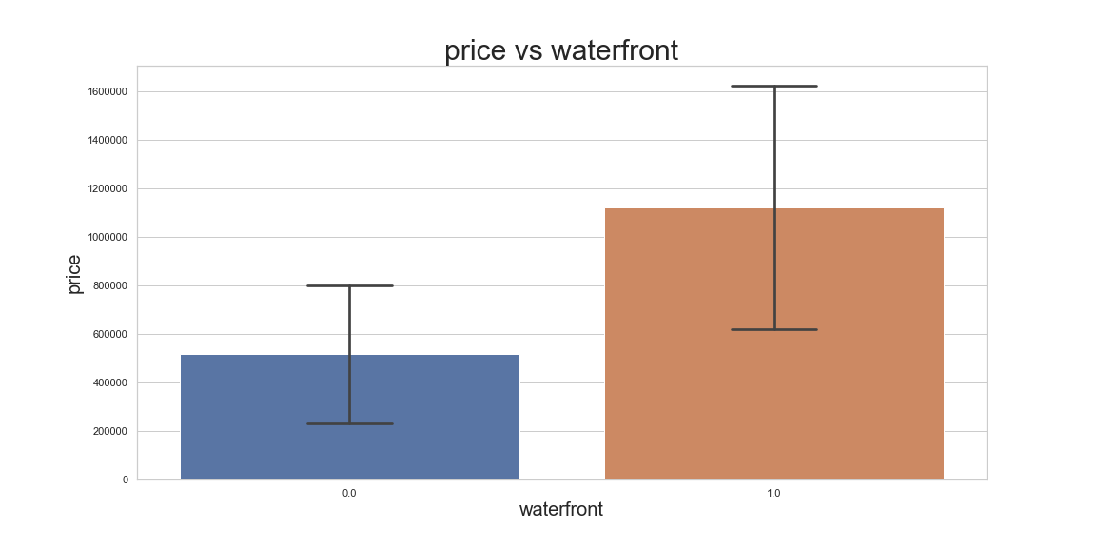
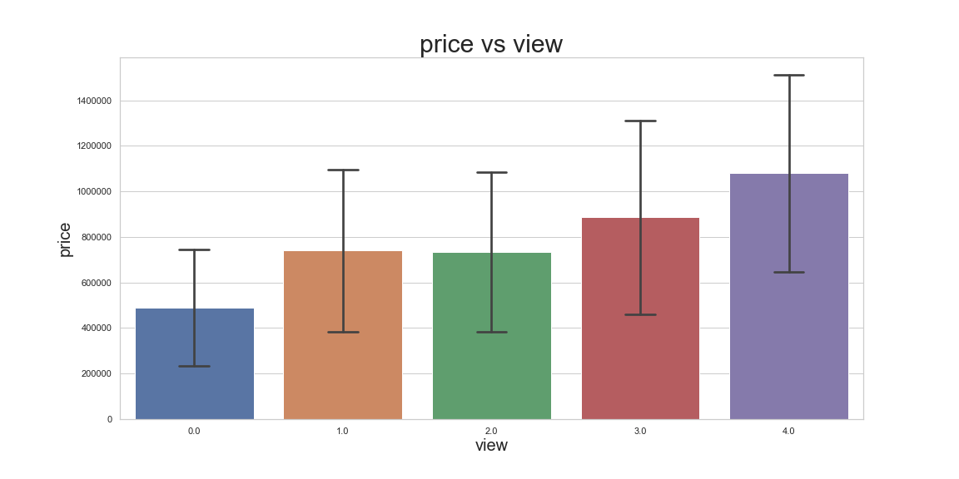
Does the look matter ?
Average price seems to increase for waterfront properties
Larger view seem to increase the property value

Slide 11
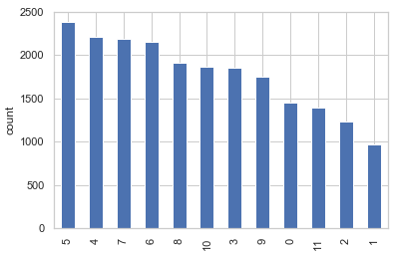
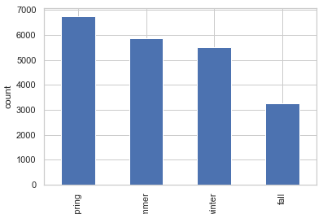
Most houses sold ? Most number of houses sold in May and in general spring and summer

Slide 12
Conclusions
Biggest factors lattitude, waterfront, bathrooms and grade
Highest mean price zipcodes are 98039, 98040 and 98004 respectively
Grade has a 2nd order correlation with mean price. For example a grade = 10 house have generally high-quality features. Finish work is better, and more design quality is seen in the floor plans. Generally have a larger square footage.
Most number of houses sold in spring and summer
For general houses 1.25 bathrooms/bedroom is the optimal
Bedrooms correlate linearly up to 5 bedrooms/house

Slide 13
Future work
More features needed. Would be good to web scrape for more features.
One year of data is not enough for proper analysis.
Further statistical tests could’ve made the model better.
More data sources can be used.
Other ML methods might be tried for more accurate modelling.

Slide 14

Acknowledgement
Amber Yandow
Dara Paoletti
Prof. Pasan Edirisinghe
Thank you

Slide 15
Extra slides

Slide 16
Grade
1-3 Falls short of minimum building standards. Normally cabin or inferior structure.
4 Generally older, low quality construction. Does not meet code.
5 Low construction costs and workmanship. Small, simple design.
6 Lowest grade currently meeting building code. Low quality materials and simple designs.
7 Average grade of construction and design. Commonly seen in plats and older sub-divisions.
8 Just above average in construction and design. Usually better materials in both the exterior and interior finish work.
9 Better architectural design with extra interior and exterior design and quality.
10 Homes of this quality generally have high quality features. Finish work is better and more design quality is seen in the floor plans. Generally have a larger square footage.
11 Custom design and higher quality finish work with added amenities of solid woods, bathroom fixtures and more luxurious options.
12 Custom design and excellent builders. All materials are of the highest quality and all conveniences are present.
13 Generally custom designed and built. Mansion level. Large amount of highest quality cabinet work, wood trim, marble, entry ways etc.

Slide 17
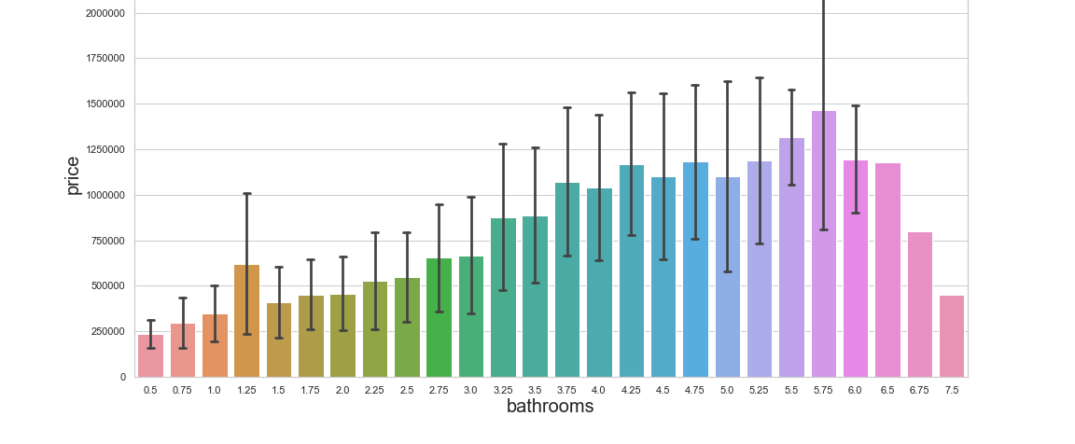
Bathroom/bedroom price variation

Slide 18
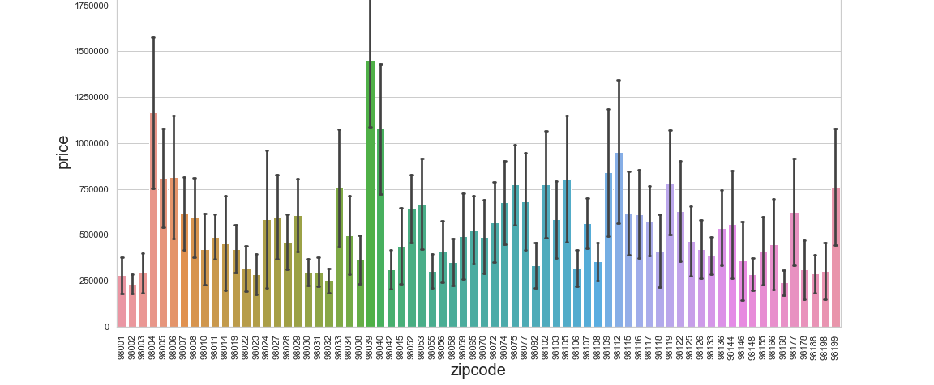
Zipcode price variation

Slide 19
The dataset
Price = ?
Discrete variables |  | Continuous variables
date sold | Year built | Living Area | Lot Area
Year renovated | # of bedrooms | Living area of 15 neighbors | Lot area of 15 Neighbors
# of bathrooms | # of floors | Area above ground | Area basement
Is waterfront property ? | View quality
condition | grade
zipcode |  | Latitude | Longitude
The resultant model is expected to pick the most essential features for house prediction out of these 19

